Slide 1
Pager Rotation Duties
Justin Marucci
Assignment 7
CSD-380

Slide 2
Pager Rotation Overview
Pager rotation is when certain engineers are "on call" and responsible for responding attend to certain incidents and threats outside of work hours.
Rotate schedules so it is fair for all engineers – this prevents engineers from overworking if they are always on call.
"You build it, you maintain it" means the people who write the code also go on-call for it. This gives developers more ownership and encourages them to test their work carefully to avoid bugs.

Slide 3
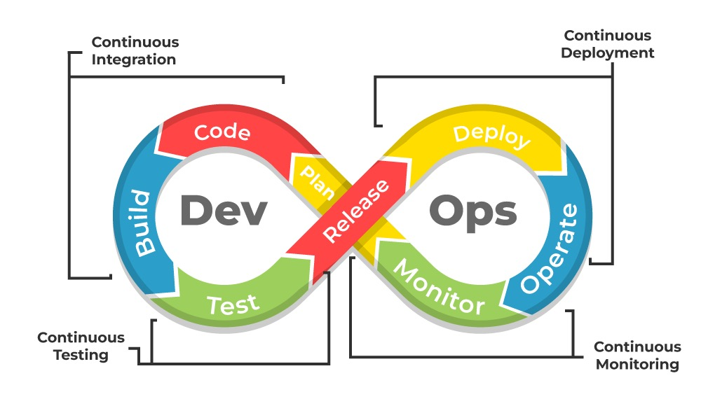
Why Use Pager Rotation?
Faster Detection - Having an engineer on call when there are problems makes it easier for the issue to be fixed in a timely manner.
Problems become visible to developers - On-call experience shows developers real issues in production, leading to better code, fewer bugs, and stronger system design.

Slide 4
Best Pager Rotation Practices – Scheduling, Culture and Collaboration
Have a fair rotation between engineers to prevent burnout and catch issues quickly
This will help keep a healthy team culture as it can feel unfair if the pager rotation schedule seems unfair
Engineers that are on call will be called to work 24/7 (even after work hours) to fix and issues that arise in the system
Scheduling roles:
Primary – 1st line of defense to attend to system issues
Secondary – Supports the Primary role (Larger issues)
Defined escalation paths: A clear process showing who to contact next if the primary and secondary cannot resolve the issue. This often includes senior engineers or specialty teams.

Slide 5
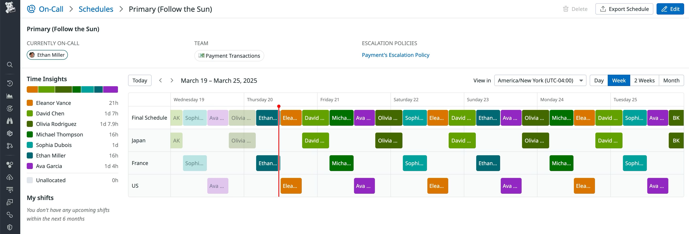
Tools Used in Pager Rotations
Alerting Tools – PagerDuty, Opsgenie
These tools help alert engineers on the rotation when there is a system issue.
They handle scheduling, escalations, notifications (SMS, phone, push), and allow teams to acknowledge or silence alerts quickly.
Monitoring Tools – Prometheus, Datadog
Collect data based on and give feedback on system health
On-Call Dashboards
Displays who is on-call, current workload, alert trends, and fairness across the rotation to prevent burnout.
See Example below:

Slide 6
Key Takeaways
Pager rotation improves reliability by ensuring someone is always available to quickly respond to system issues.
Shared on-call ownership helps developers understand real production problems, leading to better code and stronger system design.
Fair scheduling prevents burnout, keeps workloads balanced, and maintains a healthy team culture.
Clear on-call roles (primary, secondary, escalation) make incident response faster and more organized.
Monitoring and alerting tools (PagerDuty, Datadog, Prometheus) help teams detect problems early and respond efficiently.
Pager rotation supports core DevOps principles like fast feedback, continuous improvement, and full-service ownership.

Slide 7
Sources:
Cloudchipr. (2025, April 22). DevOps as a Service: What It Is, How It Works, and Why It Matters.https://cloudchipr.com/blog/devops-as-a-service
Datadog. (2025, March 26). How we structure on-call rotations at Datadog. Datadog. https://www.datadoghq.com/blog/on-call-rotations/
OpenAI. (2025). ChatGPT (Nov 2025 version) [Large language model]. https://chatgpt.com (Formatting)
PagerDuty. (n.d.). On-call management best practices. PagerDuty. https://www.pagerduty.com/
The DevOps Handbook citation (textbook): Kim, G., Humble, J., Debois, P., Willis, J., & Allspaw, J. (2016). The DevOps handbook: How to create world-class agility, reliability, & security in technology organizations (2nd ed.). IT Revolution Press.

